Slide 1


Electric Circuits
Twelfth Edition, Global Edition
Chapter 2 – Part 1
Circuit Elements
© 2024 Pearson Education Ltd. All Rights Reserved.
Notes:
If this PowerPoint presentation contains mathematical equations, you may need to check that your computer has the following installed:
1) Math Type Plugin
2) Math Player (free versions available)
3) NVDA Reader (free versions available)

Slide 2
Chapter 2 – Circuit Elements (1 of 15)
Objectives:
2.1 Understand independent and dependent sources
2.2 Understand resistors
2.3 Know and be able to use Ohm’s Law
2.4 Know and be able to use the Kirchhoff Laws
2.5 Be able to calculate the power for a circuit

Slide 3
Chapter 2 – Circuit Elements (2 of 15)
Electrical sources convert non-electric energy to electric energy.
Examples include
  Batteries: convert chemical energy to electric energy
  Generators: convert mechanical energy to electric energy
We use 2 ideal models of electric sources:
  Voltage sources, which supply the same voltage regardless of the current flow
  Current sources, which supply the same current regardless of voltage drop

Slide 4
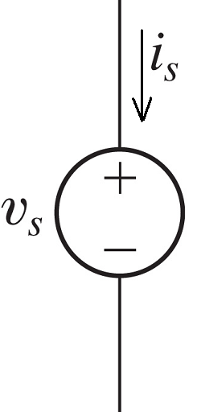
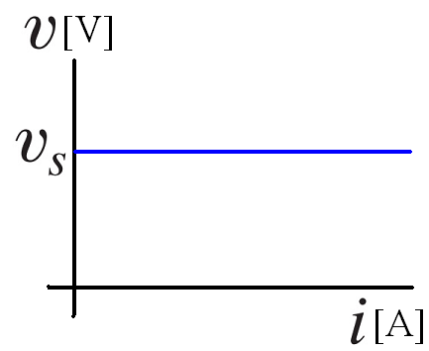
Chapter 2 – Circuit Elements (3 of 15)
Ideal independent voltage source
Observation – if all we have is the voltage drop across an ideal voltage source, there is no formula we can use to calculate the current through that source!

Slide 5
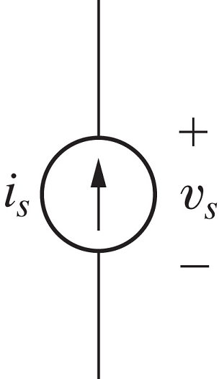
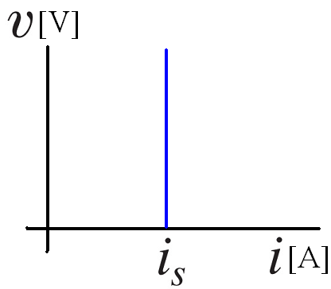
Chapter 2 – Circuit Elements (4 of 15)
Ideal independent current source
Observation – if all we have is the current flowing through an ideal current source, there is no formula we can use to calculate the voltage drop across that source!

Slide 6
Chapter 2 – Circuit Elements (5 of 15)
The sources just presented are “independent” because the voltage or current supplied by the source does not depend on any other quantity in the circuit to which it is attached.
As you might already have guessed, there are other sources that supply a voltage (or current) whose value depends on the voltage (or current) found elsewhere in the circuit.

Slide 7
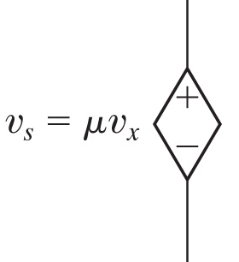
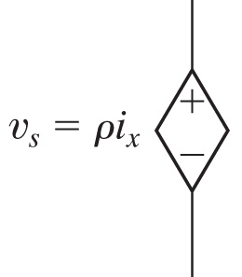





Chapter 2 – Circuit Elements (6 of 15)
Dependent voltage sources
Voltage-controlled voltage source
Current-controlled voltage source
(V C V S), where
is the voltage
(C C V S), where
is the voltage
supplied,
is the controlling
supplied,
is the controlling
voltage, and
is the gain, whose
voltage, and
is the gain, whose
units are V/V
units are V/A

Slide 8
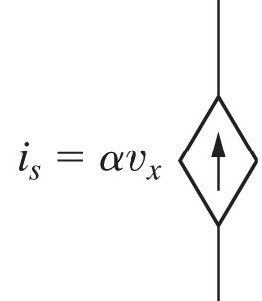
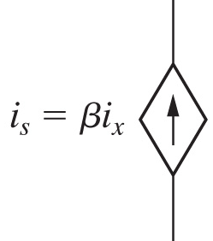




Chapter 2 – Circuit Elements (7 of 15)
Dependent current sources
Voltage-controlled current source
Current-controlled current source
(V C C S), where
is the current
(C C C S), where
is the current
supplied,
is the controlling
supplied,
is the controlling
voltage, and
is the gain, whose
current, and
is the gain, whose
units are A/V
units are A/A

Slide 9

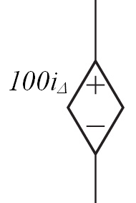


Chapter 2 – Circuit Elements (8 of 15)
If
is 15 m A, how much voltage does this dependent
source supply?
A. 15 mV
B. 1500 V
C. 1.5 V
D. 100 V

Slide 10
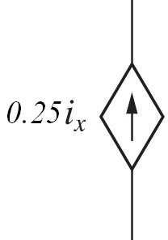
Chapter 2 – Circuit Elements (9 of 15)
What units are associated with the gain 0.25 for this dependent source?
A. V/V
B. A/V
C. V/A
D. A/A

Slide 11
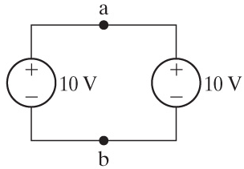
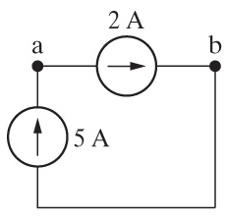
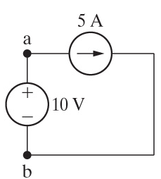
Chapter 2 – Circuit Elements (11 of 15)
Interconnected sources
When ideal sources are connected together to form a circuit, the connection is valid only if the constraints imposed by the ideal sources are not violated.
Valid or invalid?
Valid or invalid?
Valid or invalid?

Slide 12
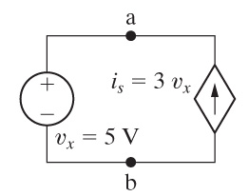
Chapter 2 – Circuit Elements (12 of 15)
Is the interconnection shown here valid?
A. Yes
B. No

Slide 13

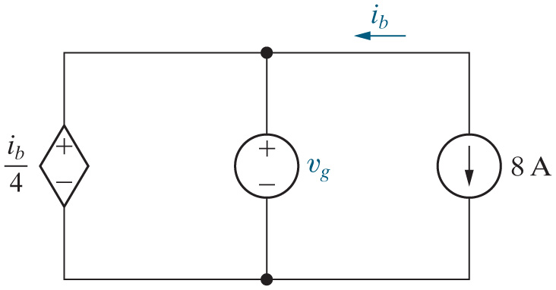
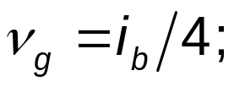

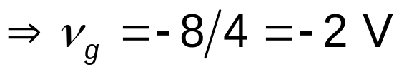
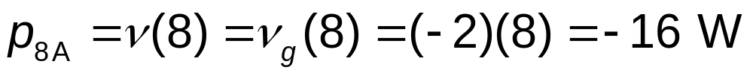
Chapter 2 – Circuit Elements (14 of 15)
Example: Find
so that the interconnection is valid. Then
find the power associated with the 8 A source.
Notes:
Long Description:
p subscript 8 Amperes Baseline equals v Open Parenthesis 8 Close Parenthesis equals v subscript g Baseline Open Parenthesis 8 Close Parenthesis equals Open Parenthesis negative 2 Close Parenthesis multiplied by Open Parenthesis 8 Close Parenthesis equals negative 16 Watts.

Slide 14
Chapter 2 – Circuit Elements (15 of 15)
We just discovered that the power associated with the 8 A source is —16 W. Is this source supplying or absorbing power?
A. Supplying
B. Absorbing

Slide 15

Copyright
This work is protected by United Kingdom copyright laws and is provided solely for the use of instructors in teaching their courses and assessing student learning. Dissemination or sale of any part of this work (including on the World Wide Web) will destroy the integrity of the work and is not permitted. The work and materials from it should never be made available to students except by instructors using the accompanying text in their classes. All recipients of this work are expected to abide by these restrictions and to honor the intended pedagogical purposes and the needs of other instructors who rely on these materials.

